Slide 1
Coordinate system & Core Graphics 44643 mobile Computing – iOS
Instructor: Dr. Chandra Mouli
Northwest Missouri State University

Slide 2
Table of contents
Introduction
Data structures
Location and size
Core Graphics
Graphics context
Some useful methods
Conclusion

Slide 3
Intro: View coordinate system
Origin is upper left corner.
Units are points, not pixels. Most of the time there are 2 pixels per point but could be only 1 or even 3.
Three key properties:
var bounds: CGRect
var center: CGPoint
var frame: CGRect
center and frame refer a UIView in its superview’s coordinate system.

Slide 4
Data structures
CGFloat – use this instead of Double or Float when playing with UIView’s coordinate system.
CGPoint – a struct with two CGFloats, namely, x and y.
CGSize – a struct with two CGFloats, namely, width and height.
CGRect – a struct with CGPoint and CGSize in it.
Lots of convenient properties and functions on CGRect.
https://developer.apple.com/documentation/coregraphics/cgrect

Slide 5
Location and size
A view’s position and size (width and height) are expressed in two ways.
frame – the rect containing a UIView in its superview’s coordinate system
bounds – a view’s internal drawing space’s origin and size
(0, 0)
550
200
View A
View A frame:
origin: (0, 0)
size: 550 x 400
View A bounds:
origin: (0, 0)
size: 550 x 400
(200, 100)
(0, 0)
View B
400
250
View B frame:
origin: (200, 100)
size: 200 x 250
View B bounds:
origin: (0, 0)
size: 200 x 250

Slide 6
Core graphics
Core Graphics, also known as Quartz 2D, is an advanced, two-dimensional drawing engine available for iOS, tvOS and macOS application development.
Quartz 2D provides low-level, lightweight 2D rendering with unmatched output fidelity regardless of display or printing device.
Quartz 2D is resolution- and device-independent.
The Quartz 2D API is easy to use and provides access to powerful features such as transparency layers, path-based drawing, offscreen rendering, advanced color management, anti-aliased rendering, and PDF document creation, display, and parsing.

Slide 7
Graphics context
A Graphics Context manages the drawing state — fill & stroke colors, line pattern, font characteristics, as well as the actual path to be drawn.
Use UIGraphicsGetCurrentContext() to get the current graphics context.

Slide 8
Constructing a Current Graphics Path
Method | Description
move(to:) | Begins a new subpath at the specified point.
addLine(to:) | Appends a straight line segment from the current point to the specified point.
addRect(_:) | Adds a rectangular path to the current path.
addEllipse(in:) | Adds an ellipse that fits inside the specified rectangle.
addArc(center:radius:startAngle:endAngle:clockwise: | Adds an arc of a circle to the current path, specified with a radius and angles.
addCurve(to:control1:control2:) | Adds a cubic Bézier curve to the current path, with the specified end point and control points.
addQuadCurve(to:control:) | Adds a quadratic Bézier curve to the current path, with the specified end point and control point.

Slide 9
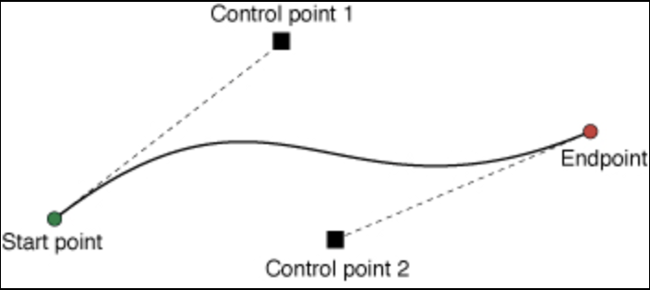
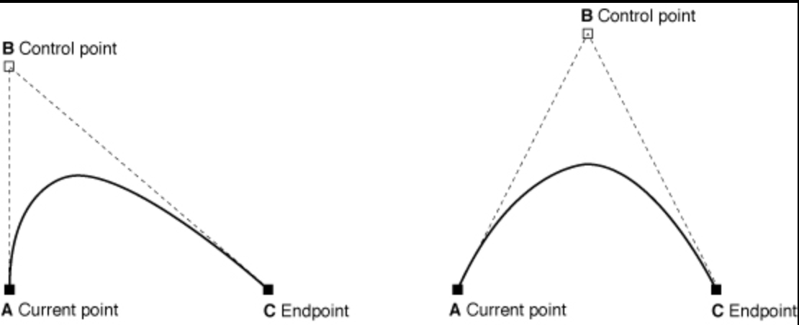
Bézier curves
A cubic Bézier curve
A Quadratic Bézier curve

Slide 10
Drawing the Current Graphics Path
Method | Description
fillPath(using:) | Paints the area within the current path, as determined by the specified fill rule.
strokePath() | Paints a line along the current path.

Slide 11
Drawing shapes
Method | Description
fill(_:) | Paints the area contained within the provided rectangle, using the fill color in the current graphics state.
fillEllipse(in:) | Paints the area of the ellipse that fits inside the provided rectangle, using the fill color in the current graphics state.
stroke(_:) | Paints a rectangular path.
stroke(_:width:) | Paints a rectangular path, using the specified line width.
strokeEllipse(in:) | Strokes an ellipse that fits inside the specified rectangle.

Slide 12
Setting Fill, Stroke, and Shadow Colors
Method | Description
setFillColor(_:) | Sets the current fill color in a graphics context, using a CGColor.
setFillColor(red:green:blue:alpha:) | Sets the current fill color to a value in the DeviceRGB color space.
setStrokeColor(_:) | Sets the current stroke color in a context, using a CGColor.
setStrokeColor(red:green:blue:alpha:) | Sets the current stroke color to a value in the DeviceRGB color space.
setAlpha(_:) | Sets the opacity level for objects drawn in a graphics context.

Slide 13
Setting Path Drawing Options
Method | Description
setLineCap(_:) | Sets the style for the endpoints of lines drawn in a graphics context.
setLineWidth(_:) | Sets the line width for a graphics context.

Slide 14
Drawing and updating the view
We subclass UIView and override the draw(_:)method to do custom drawing.
Subclasses that use technologies such as Core Graphics and UIKit to draw their view’s content should override this method and implement their drawing code there.
The setNeedsDisplay() or setNeedsDisplay(_:) method is used to notify the system that your view’s contents need to be redrawn.
The instance property contentScaleFactor determines how content in the view is mapped from the logical coordinate space (measured in points) to the device coordinate space (measured in pixels).
Either 1.0 or 2.0

Slide 15
Laying out subviews
The layoutSubviews() method.
Subclasses can override this method as needed to perform more precise layout of their subviews.
The setNeedsLayout() method.
Does not force an immediate update.
Triggers a layout update during the next update cycle.
The layoutIfNeeded() method.
Use this method to force the view to update its layout immediately.
The setNeedsDisplay() or setNeedsDisplay(_:) method is used to notify the system that your view’s contents need to be redrawn.

Slide 16
Conclusion
When using a view, usually frame is preferred. When implementing a view, bounds is preferred.
Matter of perspective:
From outside it’s usually the frame.
From inside it’s usually the bounds.
Core Graphics, also known as Quartz 2D, is an advanced, two-dimensional drawing engine available for iOS, tvOS and macOS application development.

Slide 17
Reference
https://www.youtube.com/watch?v=BuNDzuvqR9c&list=PL3d_SFOiG7_8ofjyKzX6Nl1wZehbdiZC_&index=7
https://developer.apple.com/documentation

Slide 18
Coordinate system & Core Graphics 44643 mobile Computing – iOS
Instructor: Dr. Chandra Mouli
Northwest Missouri State University

